Slide 1
Side channel example: The Cold-Boot Attack
Notes:
We talked about mechanisms for isolation. A variety of different ways to do isolation you know you for those of you who went to Neil’s talk. Neil’s talked about how Google uses honeypots and virtual machines to implement safe browsing, to implement their anti-phishing. The basic idea of course is they run the malicious code inside a virtual machine and that offers some amount of protection and the ability to reset back to a known good state. We started to allude to on the very very last slide the last time there are ofcourse all kinds of interesting attacks against isolation that we see in practice. Two broad classes of attacks that we see are side channel and covert channel. This is basically a failure of isolation. Isolation happens on the process level, the kernel level and some other trusted computer-based below the kernel like a hypervisor .Were talking about violating the notion of separation and there are not. Often times the mechanisms for doing the attacks against the isolation are quite subtle. So we’re not going to get into the science of things besides illustrating with a couple examples. We’ll talk about some interesting research in the space recently. One of the papers we worked on and some by other people that I think are interesting as well. So we alluded to this cold boot attack stuff before, so I want to go a little more into the attacks that were being performed here, then we’ll talk a little about covert channels in cloud computing envs like amazon’s ec2 and some work that my students and I have done. We’ll talk a little at the end about side channels in the context of rowhammer which was a recent attack announced by Google. So today will be examples of failures of isolation particular examples of side channels and covert channels

Slide 2
Lest We Remember Cold-Boot Attacks Against Disk Encryption
J. Alex Halderman, Seth D. Schoen, Nadia Heninger, William Clarkson, William Paul, Joseph A. Calandrino, Ariel J. Feldman, Jacob Appelbaum, Edward W. Felten
Notes:
. So this is a paper by a colleague of mine at the University of Michigan. So we're talking about the threat of data theft, we might create some sort of access control that prevents people from logging into the computer but that certainly doesn’t prevent us from taking an unencrypted hard drive from the laptop and putting it into a new laptop. Once you physically own the box you have access no matter what.

Slide 3


Data Theft Threat
OS Access Control
Attacker’s Computer

Slide 4

How Safe is a Stolen Laptop?
Unlocked Unencrypted
No protection
Locked Unencrypted
Minimal protection
Locked Encrypted
Industry best practice
Notes:
Points:
How safe is your laptop if someone steals it?
- If unlocked, no hope of protection (can access files freely)
- Screen-locked by itself not enough (can remove HD)
Locked with encrypted hard disk – thought to be safe, industry standard
We had this notion of some kind of tiered protection for good practices for laptops. An unlocked, unencrypted laptop which provides no protection. We might have laptop with locked screen which provides some protection, but doesn’t do anything once they own the drive. A locked machine that prevents them from getting access to the terminal and then an encrypted hard drive, so all data at rest is encrypted. According to paper there were 100000 stolen laptops, were they really protected? So the way this stuff typically works is that there's a mechanism that gets inserted by the software that does the cryptography, on the fly crypto but the idea is that the keys for doing the cryptography for the again the data encrypted at rest here, the keys are stored in memory someplace. So we have the key material we have to on reads and wites be able to take the data encrypt it when writing or decrypt when reading from the disk. So this supposed to prevent attackers from having access to the data even when they have full access to HD and everything else.

Slide 5
How Safe is a Stolen Laptop?
In 2007: 119,000 encrypted laptops with sensitive data lost at major US airports
Were they really protected?
Locked Encrypted
Industry best practice
Notes:
Point: (data from Ponemon Institute)
- Loads of sensitive laptops are lost or stolen in this configuration.
Is encrypting the disk *really* enough to protect them?
Research I present today suggests not.
Transistion:
Lets review how hard drive encryption works…

Slide 6
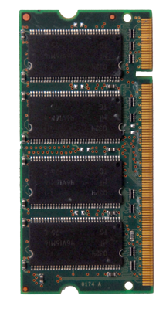

Disk Encryption Defense
Password: ********
File System
On-the-Fly Crypto
Disk Drivers
Notes:
Point:
- Let’s review how disk encryption works
Adds a transparent crypto [next] between file system and disk
Encrypts data on-the-fly as written, decrypts as read
Accessing the disk requires a key [next]
Usually derived from a password entered by user
- Key needs to be kept in RAM [next] for as long as disk is mounted
- (Nowhere else to put it!)

Slide 7
Common Attack Scenario
Security Assumptions
The encryption is strong
The OS protects the key in RAM
…the attacker might reboot to circumvent the OS, but since RAM is volatile, the key will be lost…
Right…?
Notes:
Point:
So it’s a very common scenario for the attacker to gain access a locked machine with a mounted, encrypted disk
Assume strong encryption prevents from reading disk directly
The key’s in RAM, but assume the OS won’t let him read it [next]
Sure, he could try rebooting to circumvent the OS, [next] but then, since RAM is volatile, the key will be lost ... won’t it?
The basic assumption is the key material is in RAM, volatile memory, so when you reboot key material goes away. so just a reminder of how DRAM works. Essentially a mini capacitors have little cells, you put a charge on them, you move them upto one. overtime because they are capacitors the charge dissipating in the RAM so occasionally we're going to refresh the RAM with the signals that we wanted to put on them. And what happens if we don’t refresh, we start to see a gradual degradation in the capacitor to a charge of zero. The security assumption is that this capacitor changes state instantaneously and this is absolutely not true.

Slide 8


Dynamic RAM Volatility
DRAM Cell (Capacitor)
0
0
1
1
Write “1”
Refresh (Read and rewrite)
Refresh Interval ≈ 32 ms
Security Assumptions: Data fades almost instantaneously without refresh Any residual data is difficult to recover
What if we don’t refresh?

Slide 9

Notes:
Point:
As an illustration of our findings, we loaded this bitmap into memory and read it back after cutting power for varying periods of time
(You don’t have to say it’s the Mona Lisa.)
The next example is just to illustrate how this degradation actually happens over time here is the JPEG storage or GIF stored in memory and here’s what this starts to look like overtime after you cut the power to those DRAM banks. Even 30 secs after you see some degradation but you still see resemblance to the original pictures. This assumption that it is instantaneous is not true. There is lots of information staying around as they start to discharge. 2 or 3 properties that the authors thought were interesting about the changes were that the changes actually are gradual, happens in one particular direction hight to low and that many cases is actually predictable.

Slide 10



Decay After Cutting Power
5 secs
30 secs
60 secs
300 secs
Notes:
Point:
@ 5sec virtually no data lost
Decay occurs gradually as time goes on
Even after 5 minutes, some data still visible (pause)
(Note: Black and white bars due to wiring of the chip—for some cells, absence of charge=0, others 1)

Slide 11
DRAM Remanence
Decay After Cutting Power
5 secs
30 secs
60 secs
300 secs
DRAM data disappears almost instantaneously without refresh
Gradual
Unidirectional
Predictable
Notes:
Point:
This is the phenomenon of DRAM remanence; though known to semiconductor engineers, it came as a surprise to almost everyone in the security community
Must discard assumption that DRAM data disappears immediately when power is cut [next, short pause]
Instead, [next] our experiments show, decay is gradual, on the order of seconds
It’s predominately uni-directoinal, with each cell decaying either towards 0 or towards 1
It’s predictable, allowing the attacker to learn about patterns in the decay by performing experiments on the chip
The speed of decay varies from machine to machine; newer memories, with higher circuit densities, tended to decay more quickly; but all we tested were slow enough to allow data recovery
Transition:
An attacker can use this phenomenon of DRAM Remanence to launch a new type of attack, which we call the Cold-Boot Attack.

Slide 12
Capturing Residual Data
Any residual data is difficult to recover
Residual data can be captured easily, with no special equipment
Complication Booting full OS overwrites large areas of RAM
Solution Boot a small low-level program to write out (dump) memory content
Implementations
PXE Dump (9 KB)
EFI Dump (10 KB)
USB Dump (22 KB)
Notes:
Point:
Also need to discard the assumption that recovering remaining data is hard [next]
Just need to apply power again; this start refresh, preventing
One complication…
Solution is to …
We implemented this three ways, for different platforms and I/O methods
PXE and EFI dumps boot over the network, dump data to remote machine
USB dump boots from and dumps to USB
One of the challenges that people always said that data is very difficult to recover, they show that it can actually be captured easily. One of the reasons it was thought to be difficult is there is no state or history of what was being used. Once turned off and on, the machine, the OS is free to use that memory how it wants. No mechanism to prevent overriding the bits there before. That history is gone. So we want to find mechanisms for being able to boot giving us access to that data to read without having OS or application writing over the memory we were reading. Created small programs to do that. So you can deliver these things, booting of USB sticks or booting of the network, these little small programs and then dump core memory. One problem happens if the BIOS will attempt to clear all memory on boot. There is very little you can do in terms of inserting some software. The BIOS contains the small monoprograms that get you from the hardware initial state to something capable of mounting a file system and loading a real OS whether it exists on USB or anywhere else, so you need this bios component and if the default behavior is to clear the RAM, this USB stick model won’t work. In those particular cases you need to draw an analogy to what we were doing with HDs. Take the RAM out of the other computer and put it in one where this BIOS clearing stuff doesn’t happen

Slide 13
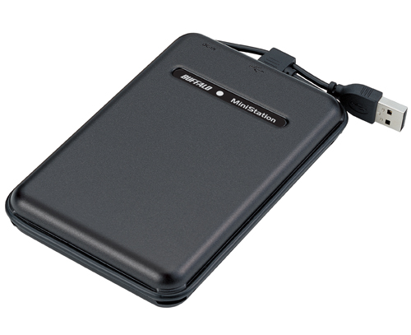
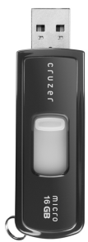
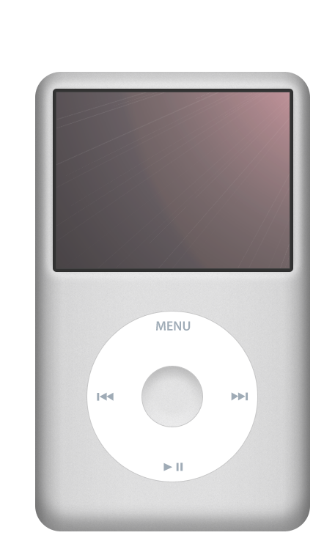
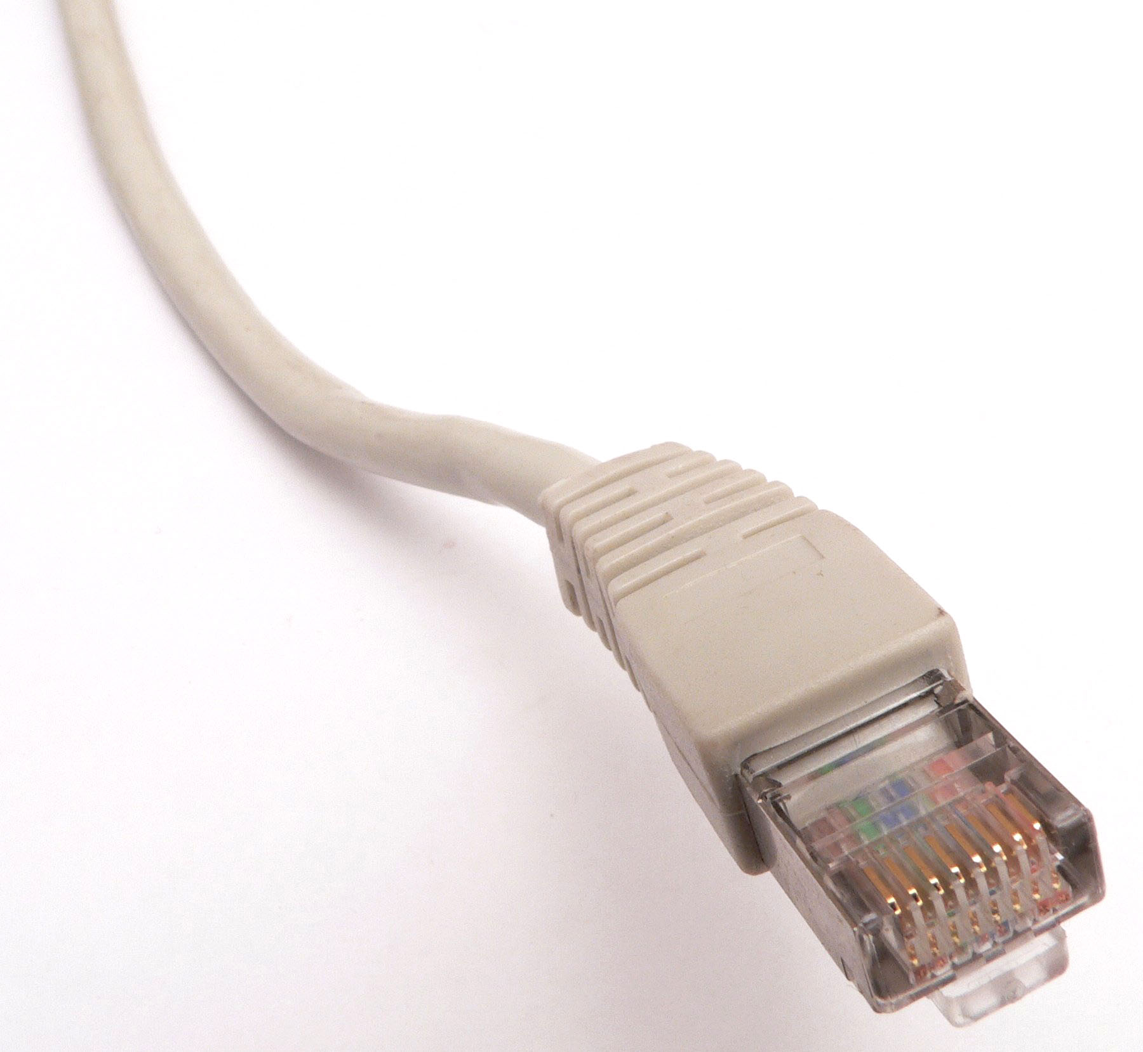
Delivering the Attack

Slide 14
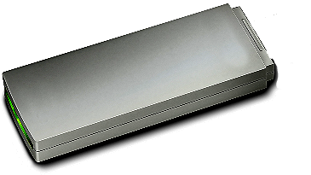
Basic Cold-Boot Attack
Dumping RAM…
Screen-locked machine (if hibernating/sleeping, just wake it up!)
Notes:
Point:
- An attacker can exploit DRAM remanence to attack most disk encryption systems
- Most basic scenario: screen locked laptop with encrypted disk mounted (if asleep or hibernating, simply wake it up)
Attacker inserts USB Stick with custom kernel
Quickly power cycles machine, booting off of USB Disk
Kernel automatically dumps memory image
Since the disk was mounted, the key must have been in memory; attacker can extract it and decrypt the disk

Slide 15
What if the BIOS clears RAM?
!!!
BIOS: Clearing RAM…
Common in machines that support ECC RAM
Notes:
Point:
But sometimes things are more complicated
Some BIOSes clear the contents of RAM on boot, preventing the attacker from dumping the data
(This is common in extended memory tests and in machines that support ECC memory)
Transition:
You might think the attacker is dead in the water, but not so…
grawlix

Slide 16
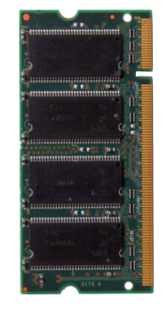
Advanced Cold-Boot Attack
Dumping RAM…
Victim’s Computer
Attacker’s Computer
Notes:
Point:
The attacker can execute a more advanced version of the attack
He can remove the memory from the PC without cutting power to the victim computer, then insert it into a computer he controls, which he has setup not to clear on boot and dump the contents there
Transition:
- RAM is without power during move, but moving it takes time. Won’t it decay too quickly?

Slide 17
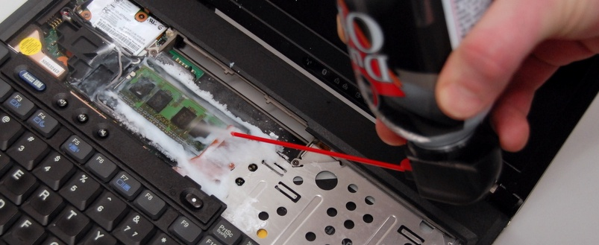
Slowing Decay By Cooling
-50°C
< 0.2% decay after 1 minute
Notes:
Point:
- Will decay too quickly to move at room temperature, but cooling the chips dramatically slows the decay
We tested a very simple cooling technique
So-called “canned air”, sprayed upside down, cools to -50 C, yielding very low decay even after 1 minute without power
. Now, there is a direct relationship between external temp and the rate at which the capacitor leaks. The colder you can keep the RAM, the less leakage you see over time. So even something simple like a can of liquid air you use to brush of keyboards. You can use that standard stuff to really reduce the temp pretty quickly and you see very significant decay over much longer time than in previous egs. You can take it out, put in another machine. You can take the RAM out dump in liquid nitrogen hold it for hours or even days before you get to the next laptop that you actually use and still be able to track some data. So clearly even with these levels we will have errors corrupting data.

Slide 18
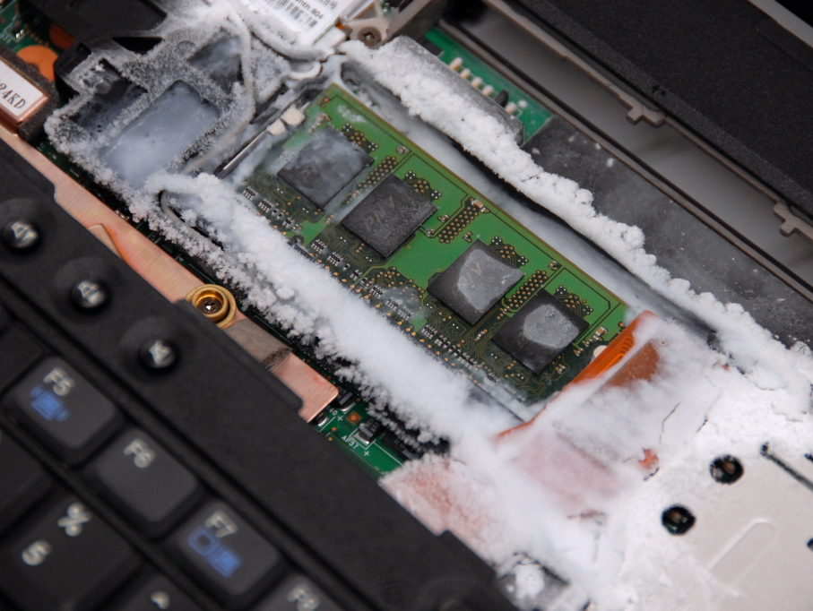
Notes:
Point:
- Here’s a close up; we dried up the condensation as well as we could, and the ram survived dozens of tests

Slide 19
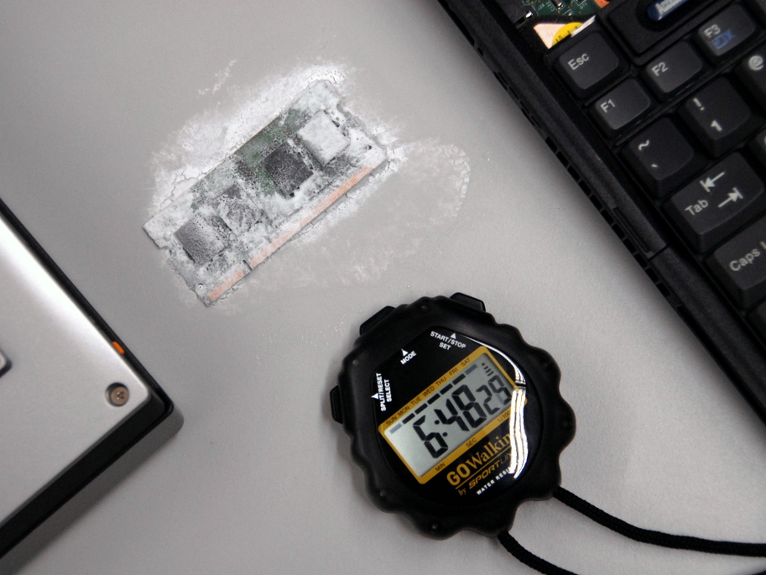
Notes:
Point:
If we keep the RAM cool, we can remove it from the computer for minutes without significant decay
This is cheap, practical way to move the RAM from one computer to another without losing much data

Slide 20
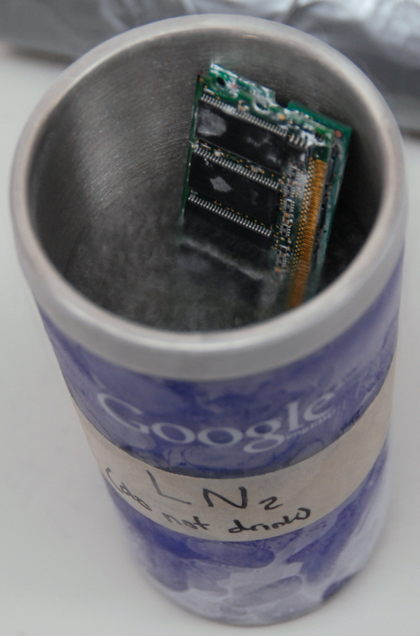
Even Cooler
Liquid Nitrogen
-196°C
< 0.17% decay after 1 hour
Not necessary in practice
Notes:
Point:
To test limits, also experimented with LN2: -196C
Only .17% decay after 1 hour
Data could remain intact for days at this temp
Transition:
Instead of cooling, another way to deal with bit errors in encryption keys is to use error correction.

Slide 21
Dealing with Bit Errors
Some bit errors inevitable, especially without cooling (increasing with memory density)
Given corrupted K’, find K:
Brute-force search over low Hamming distance to K’ e.g. 256-bit key with 10% error:
> 2⁵⁶ guesses (too slow!)
Most programs store precomputed derivatives of K (e.g. key schedules)
These derivatives contain redundancy; we can treat them as error correcting codes
Naïve Approach
Insight
Notes:
Point:
Some bit errors will occur, especially if the attacker can’t use cooling
We developed algorithms to correct errors in recovered keys
For the attacker, these are complementary to cooling, and can be used in parallel
Naïve way to think about this problem: given corrupted key K’ with a few bit errors, find original K
Naïve approach is brute-force search, but this is very slow in typical use
We had an insight: Most programs we’re interested in don’t just store K, they store pre-computed derivatives of K, such as key schedules, to improve performance
Unlike the original key, these derivatives often contain structure and redundancy – we realized we could treat them as error correcting codes to fix errors in the key more quickly
This was an unexpected performance-security tradeoff
Attacker has memory image, where corrupted key K’ is found
NAÏVE:
If error rate is low: brute-force is reasonable.
As error rate increases, hamming search gets exponentially harder
In Slide Transition:
Wouldn’t it be great if attacker had multiple copies of they key K.
It would be trivial to build majority voting scheme to determine correct bits of key K
Example: Suppose we have 10 copies of the key K. Each decays independently. If bits decay in unidirectional manner (all 1->0) and if over half of the copies have a 1 in bit position 3, then with very high likelihood the bit in position 3 is in fact 1.
Insight:
Practical implementations of Disk Encryption schemes give us something similar.
SWITCH TO VIEW INSIGHTS
Insight:
Turns out encryption schemes in practice stores a pre- computed derivative, expanded version of the key, that speeds computation. An example with a block cipher is a key schedule.
Key Schedules: not copies, but pre-computed derivatives, can be used as a special ECC Code
New Tradeoff: Performance by using key schedule vs. security of having this much information exposed
Transition:
Example of key schedule: AES

Slide 22
Recovering Other Keys
AES, DES (key schedules)
LRW tweak keys (multiplication tables)
RSA private keys (primes P and Q)
Efficiency vs. Security
Notes:
Point:
Many other disk encryption schemes store redundant data
LRW – multiplication tables
RSA – primes P and Q
Transition:
Its nice that we can recover keys, but how can we find them?
. That corruption will matter if the thing you’re looking for is a secret key. We will have to think about what to do if we want an exact copy of the original data. So we’re essentially going to apply basic information theory, error correction, we look for mechanism that allow us to correct the bit errors we see inside the RAM. So one of the things we have an advantage here, most kinds of information were interested in. Example, an RSA key pair, there are multiple different iterations that happen and we keep previous values, intermediate values as part of the key computation encryption and decryption in part of memory, so if we know the way the algorithm works and we know that the algorithm keeps these precomputed values, part of the eventual key in memory, we can use these precomputed values as error correcting nodes in building back out the original key. It’s not going to be true for everything. Clearly what’s happening here is there’s some mechanism of efficiency vs security. So you could as one solution, not keep intermediate values around and now how can you do bit correction even if you’re seeing small bit error loss. In most cases the versions of the algorithms for encryption and decryption that don’t keep these values run very slow. The sitting in between the file system and physical rive has to do entire blocks of data on the fly. It has to apply the algorithm, without any caching or optimization runs very slow. Most practical algorithms will have this kind of trade off

Slide 23
Finding Keys
Previous Methods
Entropy methods
But, most high entropy data isn’t key material
Looking for data structure
But, need to know internal details about software
Our Method
Focuses on key schedules
Precise and fully automatic, even with decay
Doesn’t require analysis of target program
Notes:
The idea is there is an assumption inside the hardware that the memory abstraction, as soon as the power goes off, this is zeroed. The hardware is leaking info about what the previous values used to be. We’ll see more mem assumption being invalidated later when we talk about rowhammer. This is an example of a side channel in the sense that the no longer powered RAM leaks info about the state of the RAM when it was powered.

Slide 24
Finding AES Key Schedules
Iterate through each byte of memory –
1. Treat following region as an AES key schedule
2. For each word in the “schedule”:
Calculate correct value, assuming other bytes correct
Take Hamming distance to observed value
3. If total distance is low, output the key
Notes:
Point:
Instead of treating each region as possible key, we look for key schedule.
Find blocks that satisfy (or almost satisfy combinatorial properties)
If hamming distance from valid key schedule is low enough, output as possible schedule
Transition:
We’ve discussed a few distinct concepts, lets put this all together.

Slide 25
Steps of Cold-Boot Attack
Extract memory
Locate keys in memory
Reconstruct decayed keys
Decrypt hard drive
Notes:
Point:
Attacker can now extract memory, find the keys, and reconstruct the keys even in the presence of errors.
Transition:
We implemented proof of concept attacks on:

Slide 26
Demonstrated Attacks
Windows BitLocker
Mac OS FileVault
Linux dm-crypt
Linux LoopAES
TrueCrypt
Notes:
Point:
Weimplemented proof of concept attacks
BitLocker (built into Vista)
FileVault (built into Leopard)
dm-crypt, loopaes,trucrypt are OSS
Transition:
As further proof of cold-boot attack, we created fully automated attack on Vista’s BitLocker.

Slide 27
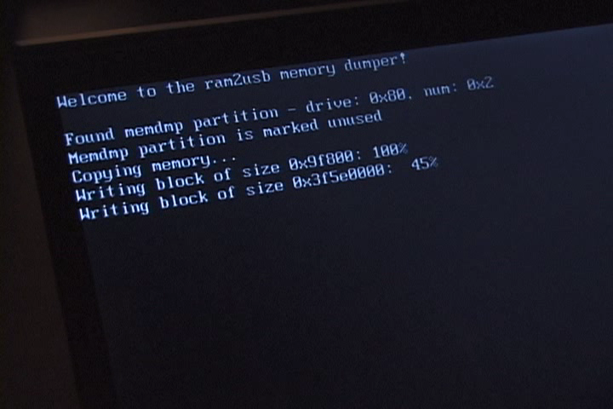
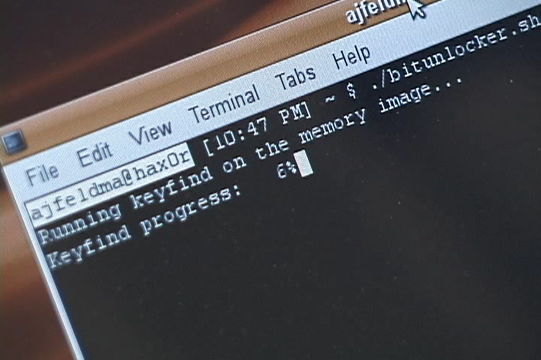
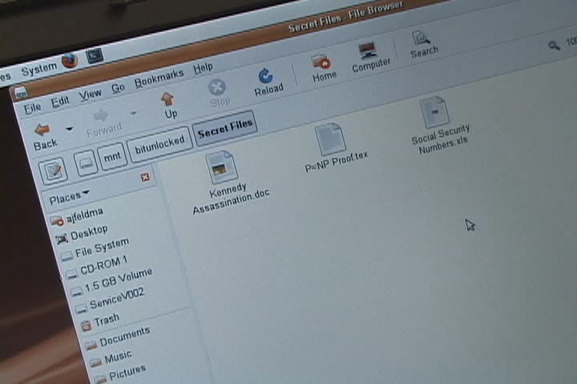
“BitLocker, Meet BitUnlocker”
Demonstration of fully automated attack: Connect USB drive, reboot, and browse files
Notes:
Point:
Simply attach USB thumb drive, and reboot
Attack is FULLY AUTOMATED
Dumps memory, Finds key, reconstructs key
and mounts disk
In fact, does not require any cooling at all
Transition:
Now that disk encryption schemes can be Cold-Boot attacked, there are a few countermeasures I’d like to discuss.

Slide 28
Countermeasures
No Magic Bullet
Possible Mitigations
Encrypt key in memory when screen-locked
Avoid precomputation
Fully encrypted memory
Trusted Platform Module (TPM)
Notes:
Point:
There is no perfect solution
All commercially available countermeasure has a drawback
Transition: I will discuss a few of the most promising countermeasures

Slide 29
Broader Lessons
Mistaken assumptions can compromise the security of otherwise good crypto
Abstractions (e.g., hardware/software divide) can hide critical behaviors and requirements
Ultimately, security is an empirical property of systems – experiments can support or overturn theory
Notes:
Point:
Summarize major points
Take home message
Transition:
Thanks

Slide 30
Covert channel example: EC2
Notes:
The distinction between side channel and covert channel is whether or not a side channel is a leakage of information, and a covert channel is violating isolation or an isolation like property in order to enable communication between 2 entities. so in a covert channel Alice and Bob want to communicate with each other they are supposed to be isolated from eachother. Not supposed to be able to communicate through some hardware mechanism
. We talked about airgaps as an isolation mechanism. There’s been some work in covert channels using microphones and speakers so both microphones and speakers in computers are capable of rendering audio that most people can’t here. Talked about pieces of computers that are airgapped but in the same physical room essentially playing nonhuman heard sounds as a mechanism to communicate without detection

Slide 31
Hey, You, Get Off of My Cloud: Exploring Information Leakage in Third-Party Compute Clouds, by
Ristenpart et al.
Notes:
Good morning everyone. Thanks for attending my talk. This work was done with my advisors at the University of Michigan, and the collaborators from the AT&T Labs research, where I did my summer internship.
We’ll talk about an example here in the context of cloud computing. This is just one of the first papers to discuss this problem

Slide 32
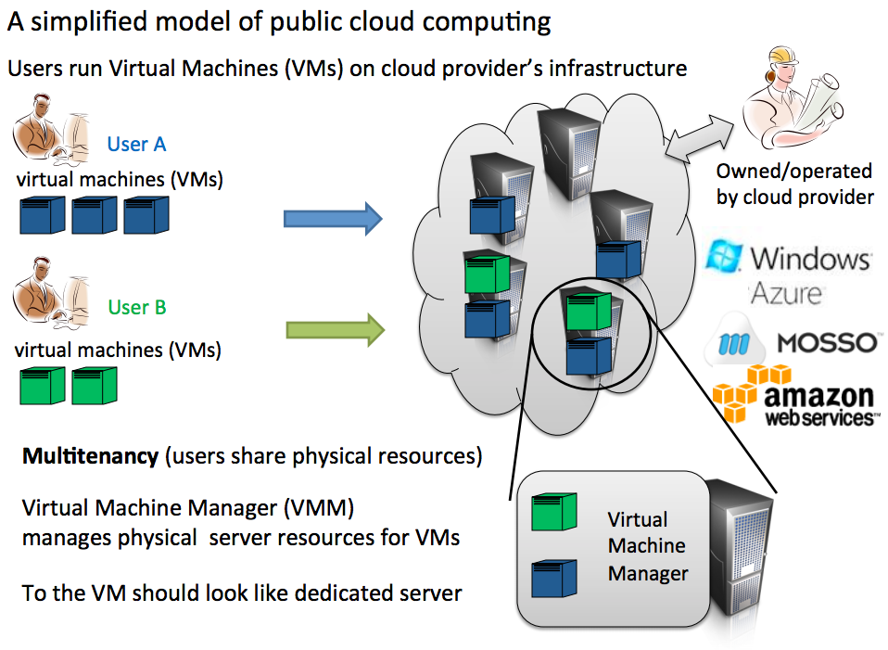
Notes:
So this is a simplified model of cloud computing, so this idea of cloud computing is this idea of cloud providers that give you infrastructure as service, so virtualized hardware. A virtualized 1RU rack mounted server that you can run your software on. This notion of multitendency in cloud computing means the cloud provider, whoever it happens to be, provide virtualized hardware infrastructure. You provide virtual machines. They run it somewhere on the cloud. You don’t have a great deal of control apart from East coast, west coast, latin america, asia pacific, but you can’t really pick which machine you’re going to run on. In fact actually what they’re going to do in most cases, they’re going to run your virtual machines alongside of other people’s VMs. Basic idea you’re probably not going to use all the resources. Much more efficient to share that resource with other VMs. So this creates a set of challenges

Slide 33
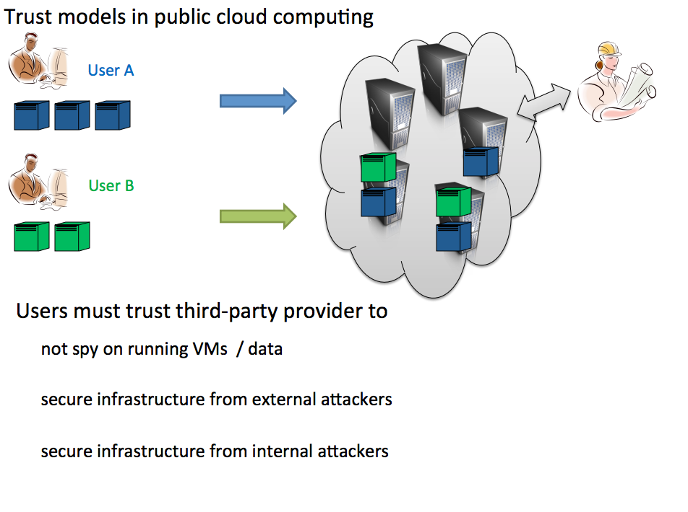
Notes:
In the cloud computing model, we have to trust Amazon not to do a bunch of things because they provide the hardware that you’re running the vms on top off. You have to trust them not tp steal your vms. If you outsource your computation and data, you have to trust that ec2 is trustworthy. You basically outsourced your data center to somebody else so that’s not just the operation of the box, you’re also outsourcing physical and virtual security of these boxes as well. You have to secure them from external and internal attackers. This is sort of the known model of security in cloud computing. It was mostly because we believed that the vm monitors, the code running on these hosts was going to be able to isolate the running vms from user A to user B

Slide 34
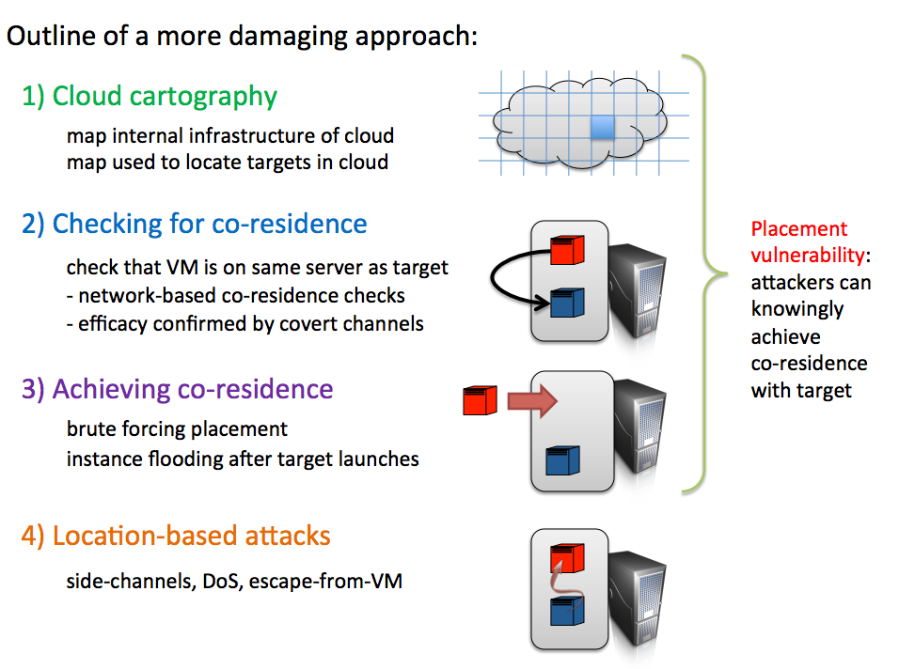
Notes:
and what the interesting thing in this particular paper from the folks at UCSD went and said that’s not correct. Actually this isolation fails in a lot of cases. You should be worried about cloud provider trustworthy and other residents of the cloud. Competitors placing vms in ec2. They talk about a collection of attacks and this again an attack in which you’re worried about a vm from an adversary being placed next to yours in the cloud env. For these attacks to be successful they believe that you have to be able to do different things. 1 is you have to be able to map out the cloud. You don’t have control over where your vm runs inside ec2. You can’t say I want this in cpu1 of machine 4 of rack 5 in the data center in SD. You get some control, giv me some boxes on East coast, west coast. The first thing you need to be able to do is map out what ec2 data center looks like and then you have to build mechanism to see if you are coresident with the vm that you want to attack. You have to have test checking to see if you are adjacent to target. You need some mechanism for using this map to place yourself over again in different places checking each time if you’re placed where you would like to be. Then exploit some class of attacks. Each of these relies on some fallacyof isolation between red and blue vm. This is the set of attacks they talked about.

Slide 35
An Exploration of L2 Cache Covert Channels in Virtualized Environments
Yunjing Xu, Michael Bailey, Farnam Jahanian
University of Michigan
Kaustubh Joshi, Matti Hitunen, Rick Schlichting
AT&T Labs Research
Notes:
Good morning everyone. Thanks for attending my talk. This work was done with my advisors at the University of Michigan, and the collaborators from the AT&T Labs research, where I did my summer internship.
Spawned interesting research I did with some of my students. Cloud infrastructure reintroduces shared hardware. We really on vm mem to apply isolation. Fails in many cases. Easiest places to see failure is in hardware that is very difficult to virtualize. Example, the layer 2 cache is actually not virtualized. Shared across vms. If there is shared hardware across 2 corunning vms, you have opportuninty for info leakage or sharing info cooperatively among vms. Particular attack is covert channel attack. Also, talk about side channel attack where a non-cooperative vm sits next to this vm it wants to spy on and they have been able to see how many webpages that vm is serving up. They have been able to do much deeper things. For certain key mechanisms extract key info, secrets from vm placed next to. In this case, covert channel. We have 2 vms that want to share info but don’t want to be detected by cloud provider. Imagine secured env with network IDS, people watching communication between hosts and you want to be able to secretly exfiltrate data. Similar to microphone and speaker bit. Needs to be secret. We have a model covert channels. We talk about this piece of work. I put this up to highlight how esoteric some of these side channels can be. You get a little sense of that when you tak about yanking RAM out of laptop and dumping in liquid nitrogen. Even talking about side channel and software, it tends to rely on complex interactions.

Slide 36
Motivation
The cloud environment (re)introduces shared hardware
While powerful, this can be abused by attackers for information leakage
Ristenpart et al. pioneering work in 2009
Forced VM co-location in EC2
Cross-VM information leakage
Covert channels
Side channels
Notes:
As we all know, cloud computing environment reintroduces the idea of shared hardware, however, while this is powerful sharing hardware among different organization can be …
For example in 2009, Ristenpart did this pioneering work in cloud computing security, where they can force attacker-controlled Virtual machines to be launched on the same physical machines as their victim VMs in EC2. And then using these co-located VMs, they implemented a set of cross-vm information leakage attacks, which includes covert channels and side channels.

Slide 37
Motivation
Cross-VM covert channel using shared L2 cache
0.2bps: proof-of-concept example
What is the maximum achievable bit rate in practice over cross-VM covert channels using L2 cache?
What factors influence the bit rate achievable in this scenario?
Notes:
Among all these attacks, the L2 based covert channel caught our attention. White this is a proof-of-concept, we struck with the low bit rate 0.2bps, with which you need 3.5 hours to leak the information on a single credit card. According to a DoD orange book, if the covert channel bandwidth is below 0.1bps they don’t even consider that as a threat. So we wonder is there any fundamental issues that limit this channel bandwidth. In particular, we ask ourselves
They talk about a proof of concept example in which they got 2 machines to communicate back and forth using this shared hardware of the L2 cache. They receive this sort of proof of concept bitrate 0.2 bits/s. The DOD orangebook was how to run a DOD secure network and what you should care about and what you should not care about. The book basically says that that bitrate doesn’t matter. DOD doesn’t worry about something that would leak info at this rate. This can exist. We have bigger fish to fry. If you start to think about this, there is no way you will do wikileaks over this. Figure some way of communicating secretly at this rate, it would take ridiculously long. Won’t spend weeks to get small amounts of text. SO they did this proof concept. Wanted to figure out how this work and if we could do any better. If that is best you can do, this a non-problem

Slide 38
Cross-VM L2 Cache Covert Channel
Processes on different VMs sharing a L2 cache can covertly communicate by manipulating the cache content
7ns * N
B
A
100ns * N/2
7ns * N/2
I₂ = log 2 = 1bit
I_{n} = log n
Notes:
Before we start exploring this problem, let’s first look at what is a cross-vm l2 cache covert channel. Basically,
Let’s see that in action. At the beginning, you have a L2 cache filled with content from process A. Now if A accesses the same memory addresses as before, theoretically, a single cache line hit will take 7ns. However, if process B from another co-located VM evicts half of A’s content from the cache, it will take about 100ns to the same memory operation for A.
Since B has two choices to evict A’s content from the cache, left or right, A can decode a bit of information each time by timing its memory operations. And theoretically, if you can divide the cache into N chunks, you may send logN bits each time. But this is not the focus of this paper. So Let’s assume one bit each time in the following discussion.
So, we talk about this process you can use the l2 cache to transfer information. So, 2 different processes that on different vms share this l2 cache and they can use it covertly by manipulating the content of the cache. It’s important to understand here, process A cannot read cache content of process B. rather we take advantages of the fact that we share this hardware to perform some timing based attacks. If you take a look at how long it takes to rea or write something from cache content. The piece of memory you look for is there or is not in the cache and has to be loaded from main memory into cache. This is the core idea. Is the thing interested in reading in the cache or not? So process B can executing, it can remove selectively cache lines by loading its own information into those cache lines and process A can load things in these cache lines and if we apply the selective loading and unloading we can actually use the timing differences to figure out whether the other processes. So if we have some elements in the cache, the memory access for that particular variable is quite quick. Howevr, if not in cache, cache miss, go out to memory and bring it back. We can take a loaded line and start to encode information, selectively remove components of it. What we choose to move is what we’re choosing to encode various bits of information. On one side you have a sender, on the other side a receiver. The way you receive is to load a variable, an array from memory and you time how long it takes to do that. In order o send you selectively remove the contents that were loaded by the receiver in memory. For example we have the receiver loading the cache line with a variety of different values. The sender is in fact selectively taking every even bit out of a byte. You’ll do larger chunks of information. This pattern is going to equal 1, agree on this pattern equaling 0

Slide 39
Bit Rate Estimation
IMPLEMENTATION
on lab machines:
Write 1bit: 1.47ms
Read 1bit: 2.34ms
Bit rate:
1bit/(1.47ms + 2.34ms)
≈ 262.47bps
>> 0.2bps
No Synchronization cost
Notes:
Given the operations for a single bit, if we do them in sequence, we can build then a covert communication channel like that. In order to estimate the maximum achievable bit rate of this channel, we measure the time to read and write a single bit using the L2 cache on our Lab machines. And they take milliseconds to finish. Thus, for each bit, consider the write and read time, we estimate the maximum bit rate to be over 260bps. But why there is a such a gap between the bit rate in .EC2.
Clearly, here we assume that the sender and receiver know exactly when to write and read the next bit, which means I overlooked the synchronization cost.
. Timing how much it takes to load this and that. If we think about how fast we can go here, the core bottleneck is how fast we can do anyone of these individual reads and writes and reading one bit being based off a combination of the write and that read. We get a much higher bitrate than 0.2bits/s. several orders of magnitude larger.

Slide 40
Cost of Synchronization
ASSUMPTION: The variation of
reading time is small, if not fixed
Acknowledge:
Busy loops until CPU
counter has big jump
Timing:
Sleep 3ms
Profiled read time:
2.34ms
1bit/(1.47 + 2.34)ms ≈ 262.47bps
1bit/(1.47 + 3)ms ≈ 223.71bps
Notes:
Move the assumptions to the end move 5 +2
As a result, next we that cost in the context. But how do you do synchronization. There are lots of approaches doing that. E.g, timing and ACK
Others suggested that sender simply sleeps a fixed amount time for each bit when the receiver is reading. We use 3ms as an example because of the profiled reading time mentioned in the last slide. Here the assumption is … On the other hand the receiver busy loops until the CPU counters jumps by a big value, which indicates the senders just did something. This approach has the assumption that…
Now we can relax the sync assumption, and give a refined estimation, which is still over 200bps.
Simply reading and writing is not enough. Ignored the cost of synchronization between these 2. You have to know when to read and know when to write at exactly the right time for this kind of stuff to work. We spend itime thinking about how to decide in between the receiver loading up the cache lines, how long does the receiver sleep before doing the next loading to receive it. If you get this wrong, there is tradeoff between how long you sleep and effect of bitrate. Can’t make it too small, writing things where the sender is writing over it. So you have to acknowledge how fast the next one can do. Wait a long enough time for things to settle down. Longer that time is, lower the bitrate. There’s lots of different ways to do this sort of signaling protocol. We look for a trade off between how long you sleep and the effective bitrates

Slide 41
Sleep time vs. Bit rate
Notes:
When we run this attack on our lab machines, where we have two Xen based vms sharing a single phuysical CPU, hence the L2 cache, given 3ms sleep 215bps is achieved with a small error rate. Even if we double the sleep time, we still get overt 100bps and reduce error rate by 4 times. So clearly this is not the dominating factor that leads us to 0.2bps
----- Meeting Notes (10/19/11 15:49) -----
1. implement
2. >200
3. And if we increase the sleep time a little bit say 6ms we can get decent error rate while the bit rate is still over 100bps
4. not odmin
At reasonable amounts of accounting for synchronization costs, we small reduction in bitrate. This is an example graph exploring bitrates vs sleep rate. When you get the sleep rate evn smaller you see higher effective bitrates but more error. We get a higher bitrate here but the error that occurs because the sender hasn’t been done writing over the various blocks as you were ready.

Slide 42
Cost of Synchronization
ASSUMPTION: The variation of
reading time is small, if not fixed
Acknowledge:
Busy loops until CPU
counter has big jump
Timing:
Sleep 3ms
1bit/(1.47 + 2.34)ms ≈ 262.47bps
ASSUMPTION:
Sender and receiver share the
physical CPU
1bit/(1.47 + 3)ms ≈ 223.71bps
Notes:
Move the assumptions to the end move 5 +2
As a result, next we that cost in the context. But how do you do synchronization. There are lots of approaches doing that. E.g, timing and ACK
Others suggested that sender simply sleeps a fixed amount time for each bit when the receiver is reading. We use 3ms as an example because of the profiled reading time mentioned in the last slide. Here the assumption is … On the other hand the receiver busy loops until the CPU counters jumps by a big value, which indicates the senders just did something. This approach has the assumption that…
Now we can relax the sync assumption, and give a refined estimation, which is still over 200bps.

Slide 43
CPU Caps
40% hard limit on EC2 small instances
Cannot communicate in 60% of time
1bit/(1.47ms + 3ms)* ≈ 223.71bps
1bit/(1.47ms + 3ms) * 40% ≈ 89.48bps
* Refer to the paper for the numbers on EC2
Notes:
It turns out that the EC2 small instances, on which the our experiments and the original proof-of-concept was conducted, there is a 40% CPU cap, which means 60% of time, two co-located VMs are effectively sharing the CPU so they cannot communicate during that time. As a result, we can refine our estimation as follows, which gives us 90bps. Now we a little closer.
. Another big deal is the fact that there is a strong assumption that processes on the same box are on the same cpu. Not true over the course of time. Zen for example will schedule various vms on different cpus so you have to account for the fact that your code may not be running adjacent on the same cpu all the time. One other interesting bit here too is that for the sizes we looked at in the paper we did, there is a hard limit for each of the cpus. Regardless how many credits, you can have no more than 40% of the cpu time. Even with this graceful communication where people are willing to yield, you can get no more than 40% cpu. So this self-bounds the amount of time you can be collocated on the same cpu and it drastically reduces your effective bitrate.

Slide 44
Core Migration
EC2 VCPUs are not pinned on physical CPU
CPU counter trick requires shared CPU
Two physical CPUs may not share L2 cache
EC2’s core migration policy is unclear
Empirical data
Notes:
Another EC2 scheduling policy the presents the sharing of CPU is core migration. EC2 VCPU…
Even worse, sometimes the VPUs of the colocated VMs are mapped to two physical CPUs that do not share the L2 cache at all. And this severely limits the cover channel communication because of a lack of sharing.
Unfortunately, the exact core migration policy is unclear in EC2. but we can do some profiling to get empirical data.
Even when you’re not talking about cpu caps, Zen has a migration policy. Your vms are not neccesarily pinned to the same cpu for the entirety of their operation. Free to move them around from time to time to do load balancing. 2 physically separate cpus don’t share same l2 cache. Since we didn’t know what the policy was, we had to empirically measure this. We see 55% of the time where the colocation period of time is only 10ms. That’s not a lot of time to share information, but there are 25% of the time when we see significant amounts of time. We’re able to get an effective bitrate when we design a protocol and spend time transferring actual real documents inside of ec2, we get 3 bits/s.

Slide 45
Profile the Core Migration
>25%
>=100ms
<= 10ms
>55%
Notes:
Put the numbers as labels
What we did was to look at the time a VCPU stays on the same pcpu between two core migrations. Here almost 60% of time, a VCPU only stays on a pcpu for no more than 10ms, during which very limited information can be transmitted. On the other hand, about 25% of time, a VCPU stays for more than 100ms, during which we can send quite some information. And later we will see implication of this distribution.

Slide 46
Sharing resistant Synchronization
Ristenpart et al.
Take multiple samples to make a decision
Revert to the beginning if core migrated
Challenges of this approach:
Effectiveness of the CPU counter technique
Repeat: how many times?
A protocol is detailed on the paper
Use L2 cache itself to indicate activities
Explore optimal number of repeats
Notes:
Given we have explored the two major reasons why the assumption about shared CPU must be challenged in EC2. The question is how do we do synchronization now.
In the original proof-of-concept attack, the authors already took the core migration into account. What they did was…
Based on that, we designed a new protocol that we believe is more resistant to EC2’s CPU scheduling policy. You can find the details on the paper. The key ideas are …

Slide 47
The Number of Samples Taken
1bit/(1.47ms + 3ms) * 40% ≈ 89.48bps
9 times
≈ 10bps
Notes:
To answer this question, we implement the new protocol in EC2 and see how well it performed. Here the number of samples taken by the sender and receivers are different is because the time to read and write are different. Given an example.
As we can see, we can achieve the best tradeoff b/t bit rate and error rate when sender repeat 9 times. 3.2bps on average. Let’s go back our estimation model if we consider repetition we should receive 10bps without considering core migration. The obvious assumption about the difference b/t 10 and 3 is due to core migration. To answer that, we need to look at the distribution of bit rates.

Slide 48
Bit Rate Distribution
Notes:
It turns out that we are able to sometimes achieve 10bps. And this bimodal distribution of channel bit rate is caused by the distribution of core migration time.
Now finally our estimation matches with the experiment result in practice. Let ‘s look back and see

Slide 49
Conclusion and Future Work
Questions to be answered
Maximum achievable bit rate
Factors influence the bit rate
A better picture
Sleep time little impact if selected right
40% CPU cap: ~200bps -> ~90bps
Core migration: ~90bps -> 10bps max, 3bps average
Data exfiltration using covert channels on EC2
No documents leaked out to wikileaks this way
Leak small secrets like private keys
Future work
Other cloud providers
Notes:
In summary, let’s see if we can answer the question we had before. Overall, we have a better picture now.
Cap & migration inherent
Other provider: cpu config: cap & migration in Rackspace
Over this threshold of 0.2 bits/s from before. This is a real concern. Are you ever going to do anything with bulk data with this? Absolutely not. But you might over an hour share some reasonably sized key. This is another example of failure of isolation.

Slide 50



Flipping Bits in Memory Without Accessing Them
DRAM Disturbance Errors
Yoongu Kim
Ross Daly, Jeremie Kim, Chris Fallin, Ji Hye Lee,
Donghyuk Lee, Chris Wilkerson, Konrad Lai, Onur Mutlu
Notes:
Hi, my name is Yoongu Kim. And today, I am presenting "Flipping Bits in Memory Without Accessing Them: An Experimental Study of DRAM Disturbance Errors." This is a work done in collaboration with my co-authors from Carnegie Mellon and Intel.
The last example is rowhammer. We’ll talk about 2 papers. Talk about the challenges and how it works. Talk about the blog post that google did and the follow up black hat presentation in which they talk about actually exploiting rowhammer to do interesting things. They talk about this assumption about how memory works.

Slide 51
DRAM Chip
Row of Cells
Wordline
Row
Victim Row
Row
Aggressor Row
V_{LOW}
Closed
V_{HIGH}
Opened
Row
Victim Row
Row
Repeatedly opening and closing a row induces disturbance errors in adjacent rows
Notes:
A DRAM chip consists of multiple rows of cells, where each row is associated with a wire called the wordline. To access a row, the wordline voltage must be increased, thereby opening the row. After accessing the row, the wordline voltage is decreased, thereby closing the row. But if we repeat this procedure, on the same row, over, and over again, we observed that some cells in adjacent rows lose their data. We refer to the row being accessed as the aggressor, and the rows having errors as its victims. In other words, repeatedly opening and closing a row induces disturbance errors in adjacent rows.
For those of you that don’t spend a lot of time thinking about memory, DRAM is arranged with banks and rows. The basic idea is that you can apply a voltage to a row to set memory in that row. When the voltage is low, the capacitor is closed. The capacitor start to discharge. In the case of rowhammer, what you’re doing is applying over and over again to that row a pattern of behavior and what happens is that adjacent rows in that bank start to see errors. So these things don’t happen completely in a vacuum. These two things are physically adjacent to eachother and you’re able to impact the rate at which the capacitor in the other row decay. So through the application here of a tight loop applying values in this particular row, you’re impacting the values in previous rows. It is a strong assumption that these rows are completely and utterly isolated from eachother.

Slide 52
Quick Summary of Paper
We expose the existence and prevalence of disturbance errors in DRAM chips of today
110 of 129 modules are vulnerable
Affects modules of 2010 vintage or later
We characterize the cause and symptoms
Toggling a row accelerates charge leakage in adjacent rows: row-to-row coupling
We prevent errors using a system-level approach
Each time a row is closed, we refresh the charge stored in its adjacent rows with a low probability
Notes:
Here is a quick summary of our paper.
First, we expose the existence, and the prevalence, of disturbance errors in DRAM chips of today. Among 129 DRAM modules that we tested, we were able to induce errors in 110 modules, all of which were manufactured in 2010 or later.
Second, we characterize the cause and symptoms of disturbance errors. When a row is repeatedly toggled, we show that it accelerates the leakage of charge in adjacent rows, through a coupling effect between the rows.
Third, we prevent errors using a system-level approach. Each time a row is opened and closed, our idea is to refresh the charge stored in the adjacent rows with a low probability, thereby offsetting the leakage effect of disturbance.

Slide 53
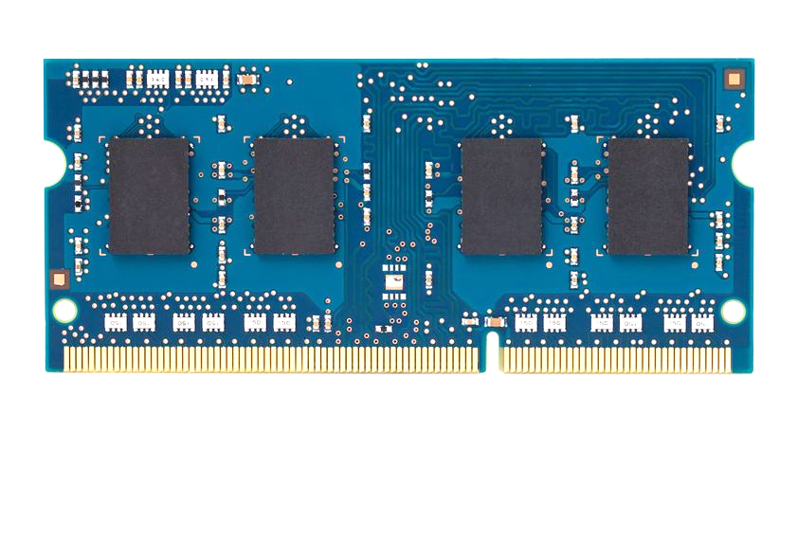
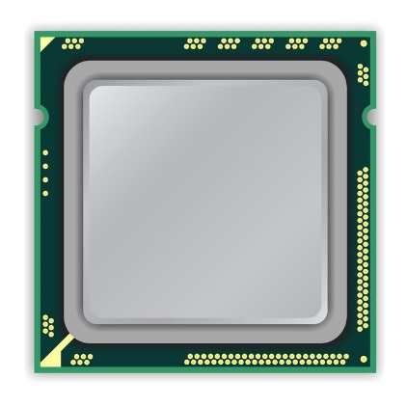
How to Induce Errors
x86 CPU
DRAM Module
DDR3
Avoid cache hits
Flush X from cache
Avoid row hits to X
Read Y in another row
111111111
X
111111111
111111111
111111111
Y
111111111
111111111
Notes:
This is the setup of the system where we induce disturbance errors. It has an x86 processor connected to a DRAM module, which is initially populated with a known data-pattern – in this case, all ‘1’s. Our goal, is to construct a program that repeatedly toggles the row at address X.
However, this cannot be achieved just by issuing many loads to address X. This is because of two reasons. First, cache hits in the processor prevent the load from reaching DRAM. But we can avoid this by flushing X from the cache. Second, when there are consecutive accesses to the same row, the processor keeps the row open without closing it. But we can avoid this by interleaving accesses to two different rows: X and Y.

Slide 54
How to Induce Errors
x86 CPU
DRAM Module
DDR3
loop:
mov (X), %eax
mov (Y), %ebx
clflush (X)
clflush (Y)
mfence
jmp loop
001110111
111111111
X
111111111
1111
111111111
101111101
110001011
111111111
Y
1111
111111111
011011110
111111111
Notes:
This is the assembly code that behaves precisely in the manner that I just described. It first opens row X and fetches a cacheline into the processor. But since the next access is to a different row, the processor is forced to close row X before opening row Y. And from row Y, another cacheline is fetched. Subsequently, the two flush instructions evict the cachelines from the processor. Each iteration of the code toggles the two rows X and Y, and after many iterations, many errors appear in adjacent rows.
People that do mem design know these errors exist and attempt to minimize them. So aggressor rows are trying to impact victim rows. You’re trying to get some disturbance in the victim rows. The big deal in this particular paper is that they exist that this happening and talk about its prevalence and measure across a bunch of different chips and they spend some time thinking about where the actual coupling is happening between the actual rows. A violation of this assumption of isolation. One row should not impact another. So, how this works is there is a couple of different errors to worry about. One of them is you have a memory hierarchy and so if you want to actually go into the main memory, you have to avoid cache hits because if trying to write program to do this you can’t hit the cache. You need to go into memory each time. Thee are mechanisms to provide that. You also want to be able to get around other memory optimizations. It is also the case that if you are constantly accessing that same row, the memory subsystem is going to optimize for that and it is not going to continue its writes to that same piece of memory its essentially going to do cacheing. The other thing to do is make sure that you interchange accesses to the aggressor row with accesses to some other row someplace else to turn off that optimization. You’re gonna move a particular value from eax into the row of memory. You want to look at, interweaving some non aggressor rows, you’re gonna do flush force this to be evicted from the cache and sort of do this in a very tight loop. This is you just hammering that one row over and over again.

Slide 55
Security Implications
Breach of memory protection
OS page (4KB) fits inside DRAM row (8KB)
Adjacent DRAM row → Different OS page
Vulnerability: disturbance attack
By accessing its own page, a program could corrupt pages belonging to another program
We constructed a proof-of-concept
Using only user-level instructions
Notes:
In addition, they have serious implications for security
When disturbance errors occur, they could breach memory protection. This is because an OS page fits inside a DRAM row. So an error in a different DRAM row means an error in a different OS page.
This opens up a vulnerability to disturbance attacks. Just by accessing its own page, a malicious program could corrupt pages belonging to another program.
And, as shown previously, we constructed a proof-of-concept using only user-level instructions.

Slide 56
Notes:
. So, basically this paper was done a year ago, showed this was possible. Showed that the violation of the isolation can result in the aggressor row corrupting values in the victim rows. They positive that if you can corrupt adjacent rows, you can do all kinds of things. You can make systems crash if you put random values in places. If we crash in just the right way we might be able to do security things that we like to not have happen. They didn’t really go much farther than that other than say it is a possibility. Just this year, this group wrote this blog post talking about how they took this idea and actually used it to selectively write important things to memory. How do you create random errors in rows adjacent to you, where randomness actually helps you? You don’t have a lot of control over what bits or bytes are being flicked and what they get flipped to. Generally there’s this issue of what can you do to the bits next to you an then the issue of finding some place in memory where it would be useful to flip the bits. You’d be interested in something like a control flow issue you can change, or changing the bit on a page does something, but knowing where that is in memory is actually hard to do as well. You don’t necessarily what is going to happen when you hammer a set of rows and where you’re going to find the interesting parts. You’re looking at some kid of boundary, you’d be looking for a situation to exploit where you have memory that you can use and write things to that is adjacent to memory that you don’t have control over, because somebody else has memory, property bit on a page someplace. Just like the example before, it is one thing to say these channels exist, another thing to go from the basic idea of them happening to do something very useful

Slide 57
Notes:
So, they talk about in there example that they used rowhammer to break out of a lot of different things. They talk about the sandbox that chrome runs and how they can break out of the chrome sandbox. They talked about doing kernel exploits and how they’re going to attempt to get privileged access in the kernel using rowhammer. In order to understand how this is going to work. In x86 there’s page table entries that they control access to physical memory. The page table entries help us index the physical memory. It turns out page table entries, because they do this indirect mapping between virtual address and physical address can give you control over pieces of physical memories if you have a mapping to that physical address. The basic idea is that we’re gonna get access to a page table and attempt to modify it in a way that give us access to physical memory we shouldn’t have access to. From there we can do all kinds of things like write to basically passwords, keys, all kinds of useful things. We’re going to do something called spraying which you’ve seena bit of, atleast alluded to in some of the buffer overflow and exploit stuff

Slide 58
Notes:
This is what 64 bit x86 page table entry looks like. One thing that we might choose to do is try to get ourselves next to a page table entry inside of physical memory and try to flip an important bit like the writeable permission bit. Unfortunately this bit is quite small compared to the page table entry, so the chance that it is a position that we can flip it to something useful is quite small. Instead you can see that the page table number it points to is quite large and we have a much larger chance of being able to modify that if we are adjacent to one of these page table entries. We’re talking about virtual addressing, so we have some virtual address space oftentimes much larger than physical address space. What happens when we map a file with a read write permissions. We have some sort of mapping with that virtual address space, and some block of physical memory. When we map this via virtual memory opposed to doing a direct mapping, we have these page table entries that are essentially a small block of memory that does this translation between virtual and physical addresses.

Slide 66
Notes:
. These little pieces of memory full of page table entries pointers to physical memory. Repeatedly map a file directly, we see something like this. When we repeatedly map through virtual memory manager, we have multiple pt entries for virtual addresses pointing to potentially the same physical address location. The key here is that because we can create more pt entries by repeatedly mapping virtual addresses to a same block in the memory. We can essentially fill up large swathes of memory with pt entries all of which wind up pointing to the same physical block in memory. So, if we can apply the rowhammer attack and it just so happens that we can get the right bit in the right place, we can essentially make that pt entry now point to some other point in memory. Because we filled all of these pt entries, this is essentially going to allow us to access through this virtual address space the memory in a page table

Slide 71
Notes:
This pointer now is pointing to a pt entry that we can in fact actually modify. This allows us to do is we can now essentially remap all the virtual and physical memory. That allows us to do all kinds of interesting things. Go ahead and modify the contents of some secret, password or a log. Even this sort of complicated shift from the ability to flip bits to finding a pattern to flip bits which are useful to you. There are lots of reasons why going through these sort of processes, lots of complications here as well. We had an isolation assumption that rows inside of memory should not be able to impact eachother and were actually able to violate that assumption and the translation of that isolation violation is actually practical.

